Slide 1
Introduction to HIVE
Presented By
Rahul Pradhan
Dept of Computer Engineering & Applications
GLA University India

Slide 2
Agenda
Learning Objectives | Learning Outcomes
Introduction to Hive To study the Hive Architecture To study the Hive File format To study the Hive Query Language | To understand the hive architecture. To create databases, tables and execute data manipulation language statements on it. To differentiate between static and dynamic partitions. To differentiate between managed and external tables.

Slide 3
Agenda
What is Hive?
Hive Architecture
Hive Data Types
Primitive Data Types
Collection Data Types
Hive File Format
Text File
Sequential File
RCFile (Record Columnar File)

Slide 4
Agenda …
Hive Query Language
DDL (Data Definition Language) Statements
DML (Data Manipulation Language) Statements
Database
Tables
Partitions
Buckets
Aggregation
Group BY and Having
SERDER

Slide 5
What is Hive?
Hive is a Data Warehousing tool. Hive is used to query structured data built on top of Hadoop.
Facebook created Hive component to manage their ever-growing volumes of data. Hive makes use of the following:
1. HDFS for Storage
2. MapReduce for execution
3. Stores metadata in an RDBMS.

Slide 6
What is Hive ?
Apache Hive is a popular SQL interface for batch processing on Hadoop.
Hadoop was built to organize and store massive amounts of data.
Hive gives another way to access Data inside the cluster in easy, quick way.

Slide 7
Features of Hive
It is similar to SQL.
HQL is easy to code.
Hive supports rich data types such as structs, lists, and maps.
Hive supports SQL filters, group-by and order-by clauses.

Slide 8
Hive Architecture
Hive
Command-Line Interface
Hive Web Interface
Hive Server (Thrift)
Driver (Query Compiler, Executor)
Metastore
JobTracker
TaskTracker
HDFS
Hadoop

Slide 9
Hive Architecture
The various parts are as follows:
Hive Command-.Line Interface (Hive CLI): The most commonly used interface to interact with Hive.
Hive Web Interface: It is a simple Graphic User Interface to interact with Hive and to execute query.
Hive Server: This is an optional server. This can be used to submit Hive Jobs from a remote client.
JDBC / ODBC: Jobs can be submitted from a JDBC Client. One can write a Java code to connect to Hive and submit jobs on it.

Slide 10
Hive Architecture
Driver: Hive queries are sent to the driver for compilation, optimization and execution.
Metastore: Hive table definitions and mappings to the data are stored in a Metastore. A Metastore consists of the following: 'Metastore service: Offers interface to the Hive. ' Database: Stores data definitions, mappings to the data and others.
The metadata which is stored in the metastore includes IDs of Database, IDs of Tables, IDs of Indexes etc, the time of creation of a Table, the Input Format used for a Table, the Output Format used for a table etc. The metastore is updated whenever a cable is created or deleted from Hive. There are three kinds of metastore.

Slide 11
Hive Architecture
1. Embedded Metatore: This metastore is mainly used for unit tests. Here, only one process is allowed to connect to the metastore at a time. This is the default metastore for Hive. It is Apache Derby Database. In this metastore, both the database and the metastore service runs, embedded in the main Hive Server process. Figure 9.8 shows an Embedded Mecastore.
2. Local Metastore: Metadata can be stored in any RDBMS component like MySQL Local metastore allows multiple connections at a time. In this mode, the Hive metastore service runs in the main Hive Server process, but the metastore database runs in a separate process, and can be on a separate host, Figure 9.9 shows a local Metastore.

Slide 12
Hive Architecture
3. Remote Metastore: In this, the Hive driver and the metastore interface run on different JVMs (which can run on different machines as well) as in Figure 9.10. This way the database can be fire-walled from the Hive user and also database credentials are completely isolated from the users of Hive.

Slide 13
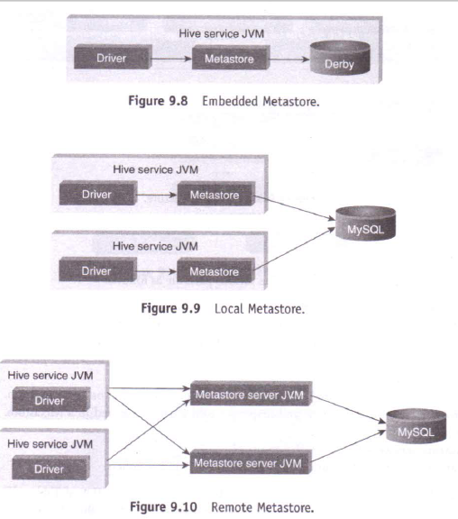

Slide 14
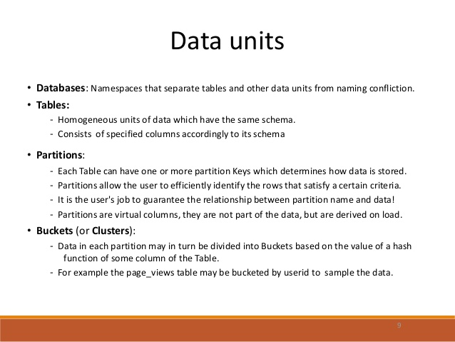
Hive Data Units

Slide 15
Hive Data Model Contd.
Tables
- Analogous to relational tables
Each table has a corresponding directory in HDFS
Data serialized and stored as files within that directory
- Hive has default serialization built in which supports compression and lazy deserialization
- Users can specify custom serialization –deserialization schemes (SerDe’s)

Slide 16
Hive Data Model Contd.
Partitions
Each table can be broken into partitions
Partitions determine distribution of data within subdirectories
Example -
CREATE_TABLE Sales (sale_id INT, amount FLOAT)
PARTITIONED BY (country STRING, year INT, month INT)
So each partition will be split out into different folders like
Sales/country=US/year=2012/month=12

Slide 17
Hierarchy of Hive Partitions
/hivebase/Sales
/country=US
/country=CANADA
/year=2012
/year=2012
/year=2015
/year=2014
/month=12
/month=11
/month=11
File
File
File

Slide 18
Partition
The general definition of Partition is horizontally dividing the data into number of slice in a equal and manageable manner.
Every partition is stored as directory within data warehouse table.
In data warehouse this partition concept is common but there is two types of Partitions are available in data warehouse concepts.
There are i) SQL Partition ii) Hive Partition

Slide 19
Hive Partition
The main work of Hive partition is also same as SQL Partition but
the main difference between SQL partition and hive partition is SQL partition is only supported for single column in table but in Hive partition it supported for Multiple columns in a table .
The main work of Hive partition is also same as SQL Partition but the main difference between SQL partition and hive partition is SQL partition is only supported for single column in table but in Hive partition it supported for Multiple columns in a table .

Slide 20
Hive Data Model Contd.
Buckets
Data in each partition divided into buckets
Based on a hash function of the column
H(column) mod NumBuckets = bucket number
Each bucket is stored as a file in partition directory

Slide 21
Hive Data Types
Numeric Data Type
TINYINT | 1 - byte signed integer
SMALLINT | 2 -byte signed integer
INT | 4 - byte signed integer
BIGINT | 8 - byte signed integer
FLOAT | 4 - byte single-precision floating-point
DOUBLE | 8 - byte double-precision floating-point number
String Types
STRING
VARCHAR | Only available starting with Hive 0.12.0
CHAR | Only available starting with Hive 0.13.0
Strings can be expressed in either single quotes (‘) or double quotes (“)
Miscellaneous Types
BOOLEAN
BINARY | Only available starting with Hive

Slide 22
Hive Data Types cont..
Collection Data Types
STRUCT | Similar to ‘C’ struct. Fields are accessed using dot notation. E.g.: struct('John', 'Doe')
MAP | A collection of key - value pairs. Fields are accessed using [] notation. E.g.: map('first', 'John', 'last', 'Doe')
ARRAY | Ordered sequence of same types. Fields are accessed using array index. E.g.: array('John', 'Doe')

Slide 23
Database
To create a database named “STUDENTS” with comments and database properties.
CREATE DATABASE IF NOT EXISTS STUDENTS COMMENT 'STUDENT Details' WITH DBPROPERTIES ('creator' = 'JOHN');

Slide 24
Tables
There are two types of tables in Hive:
Managed table
External table
The difference between two is when you drop a table:
if it is managed table hive deletes both data and meta data,
if it is external table hive only deletes metadata.
Use external keyword to create a external table

Slide 25
Tables
To create managed table named ‘STUDENT’.
CREATE TABLE IF NOT EXISTS STUDENT(rollno INT,name STRING,gpa FLOAT) ROW FORMAT DELIMITED FIELDS TERMINATED BY '\t';

Slide 26
Tables
To create external table named ‘EXT_STUDENT’.
CREATE EXTERNAL TABLE IF NOT EXISTS EXT_STUDENT(rollno INT,name STRING,gpa FLOAT) ROW FORMAT DELIMITED FIELDS TERMINATED BY '\t' LOCATION ‘/STUDENT_INFO;

Slide 27
Tables
To load data into the table from file named student.tsv.
LOAD DATA LOCAL INPATH ‘/root/hivedemos/student.tsv' OVERWRITE INTO TABLE EXT_STUDENT;
To retrieve the student details from “EXT_STUDENT” table.
SELECT * from EXT_STUDENT;

Slide 28
Partitions
Partitions split the larger dataset into more meaningful chunks.
Hive provides two kinds of partitions: Static Partition and Dynamic Partition.
To create static partition based on “gpa” column.
CREATE TABLE IF NOT EXISTS STATIC_PART_STUDENT (rollno INT, name STRING) PARTITIONED BY (gpa FLOAT) ROW FORMAT DELIMITED FIELDS TERMINATED BY '\t';
Load data into partition table from table.
INSERT OVERWRITE TABLE STATIC_PART_STUDENT PARTITION (gpa =4.0) SELECT rollno, name from EXT_STUDENT where gpa=4.0;

Slide 29
Buckets
Tables or partitions are sub-divided into buckets, to provide extra structure to the data that may be used for more efficient querying. Bucketing works based on the value of hash function of some column of a table.
We can add partitions to a table by altering the table. Let us assume we have a table called employee with fields such as Id, Name, Salary, Designation, Dept, and yoj.

